Slide 1
Lab 3 2^K
By Karan Sahu and Anh Tran

Slide 2


How our program works and big N
Show program

Slide 3
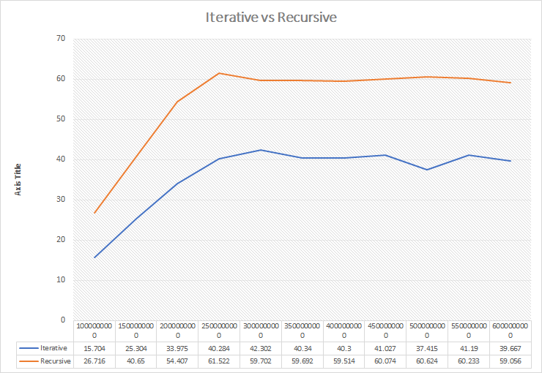
Time analysis

Slide 4
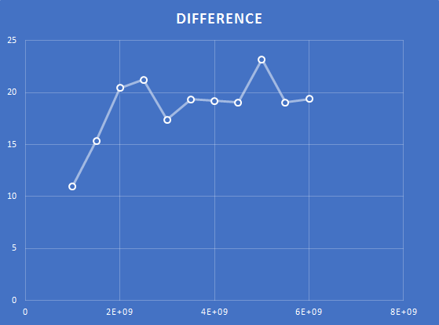
Difference
Difference
11.012
15.346
20.432
21.238
17.4
19.352
19.214
19.047
23.209
19.043
19.389
11 Trails

Slide 5
Conclusion, Observation(iterative vs recursion)
Iterative Solution has better time efficiency than recursive method at all points of trials
Average of about 18.6 seconds slower this average would be closer to 20 with more data points based on the trend
Same Big N(64) due to the fact that the issue is coming from the unsigned long long int not being able to hold the value.
For some reason the programs time efficiency for both recursive and iterative went up in down at some points as # trials increased
Iterative solution Wins!!

Slide 6
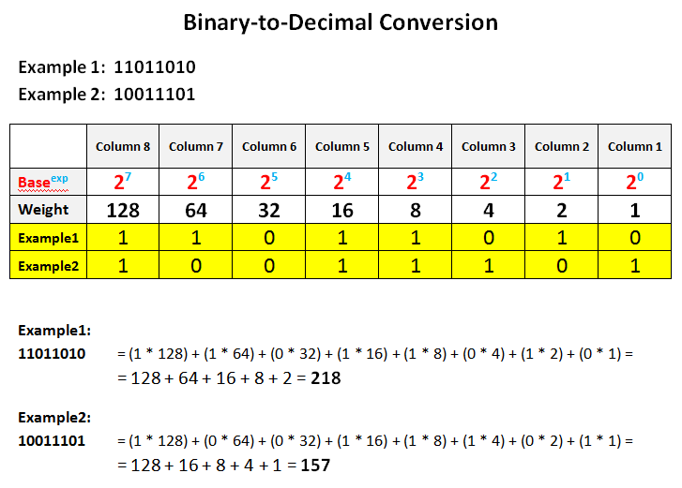
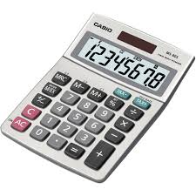
Real life application

